Slide 1
Deep Reinforcement Learning
Dr. Aygul Zagidullina

Slide 2
Outline
Introduction to Reinforcement Learning
Break
Introduction to Q-Learning (RL)
Break
Deep Q-Learning (RL)

Slide 3
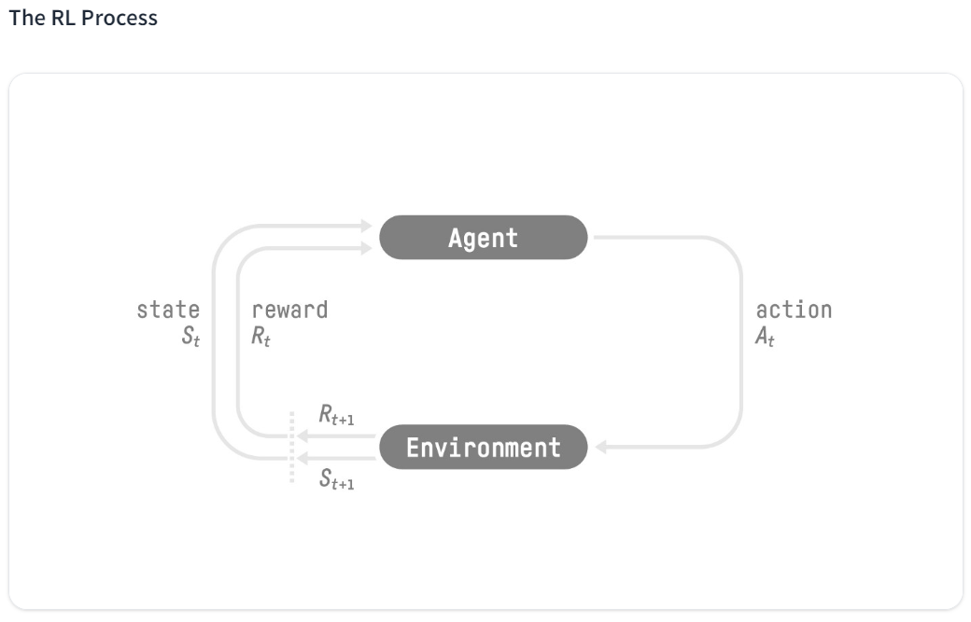
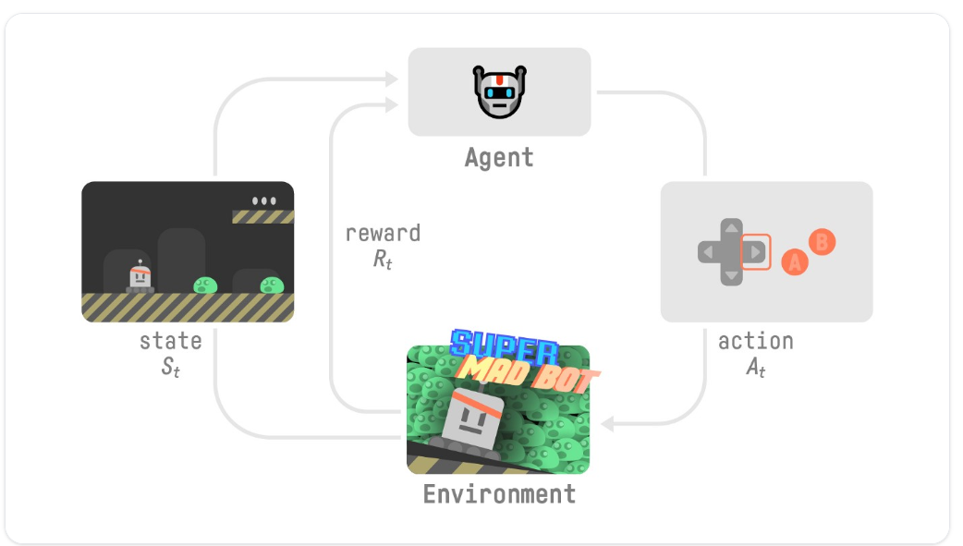
Reinforcement Learning: Introduction

Slide 4
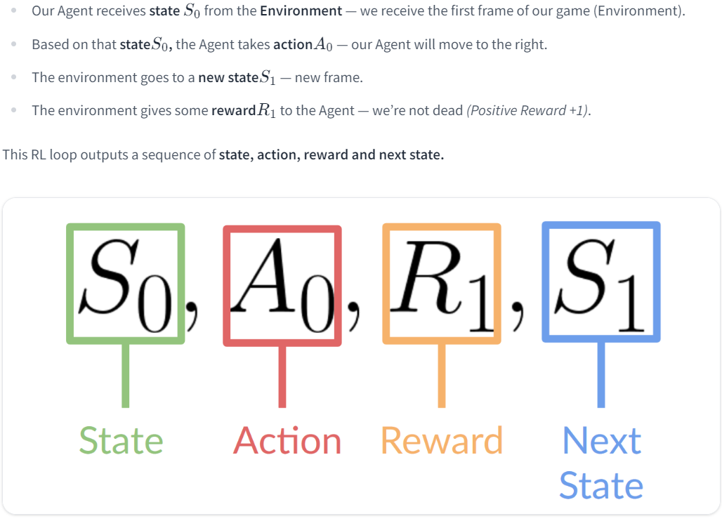
Reinforcement Learning: Introduction

Slide 5
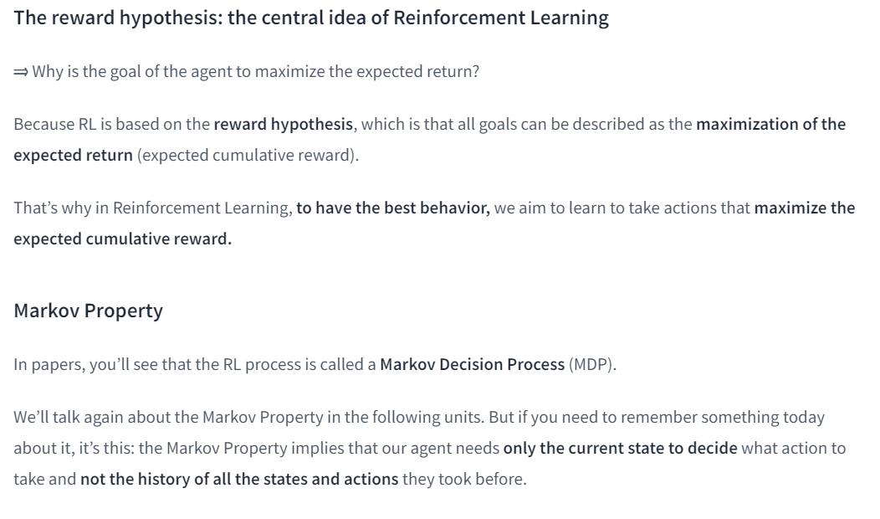
Reinforcement Learning: Introduction

Slide 6
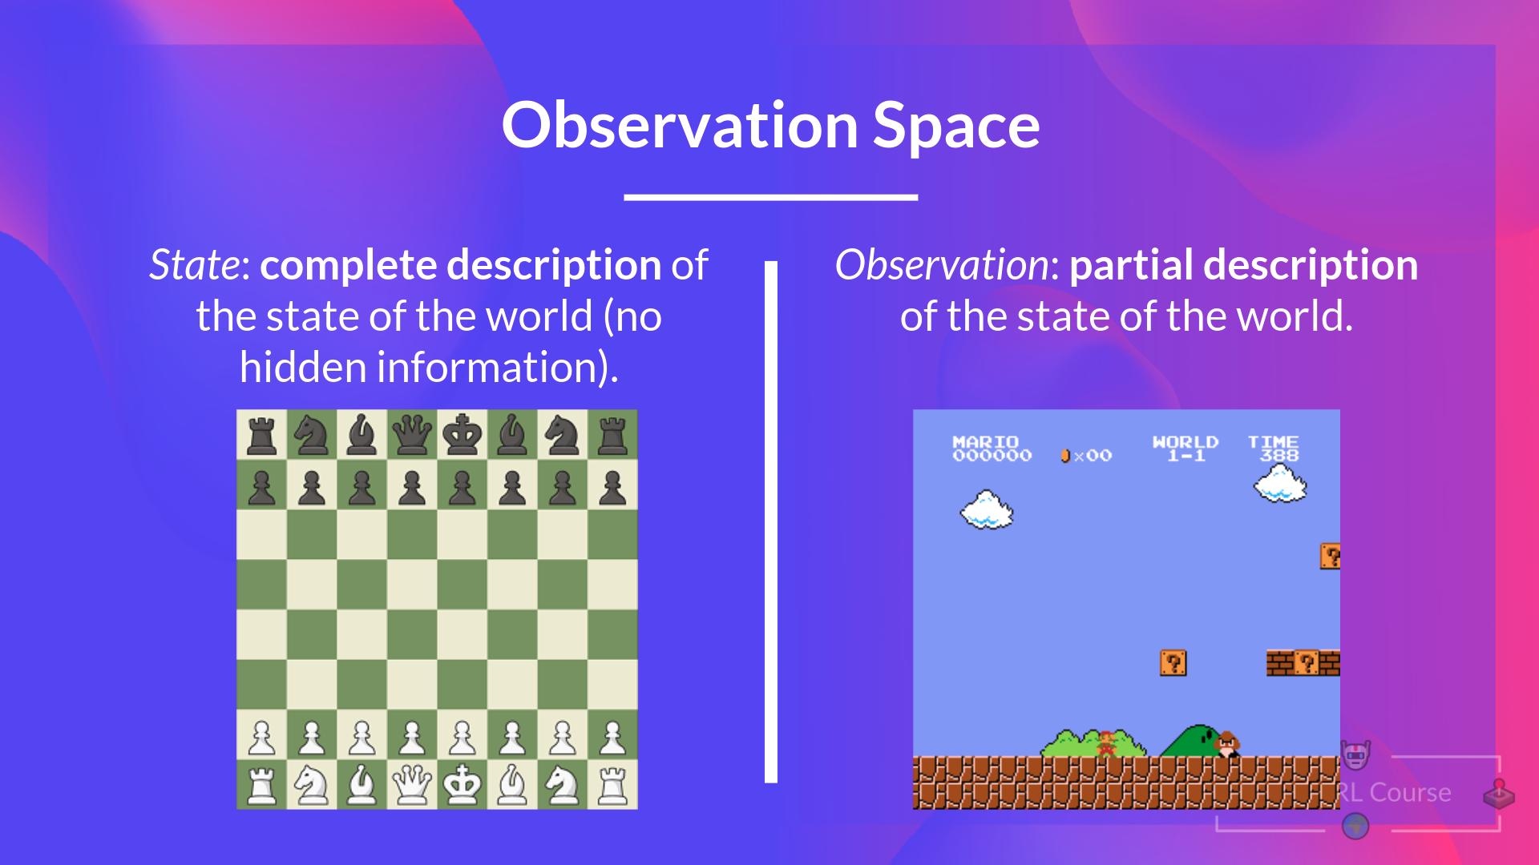
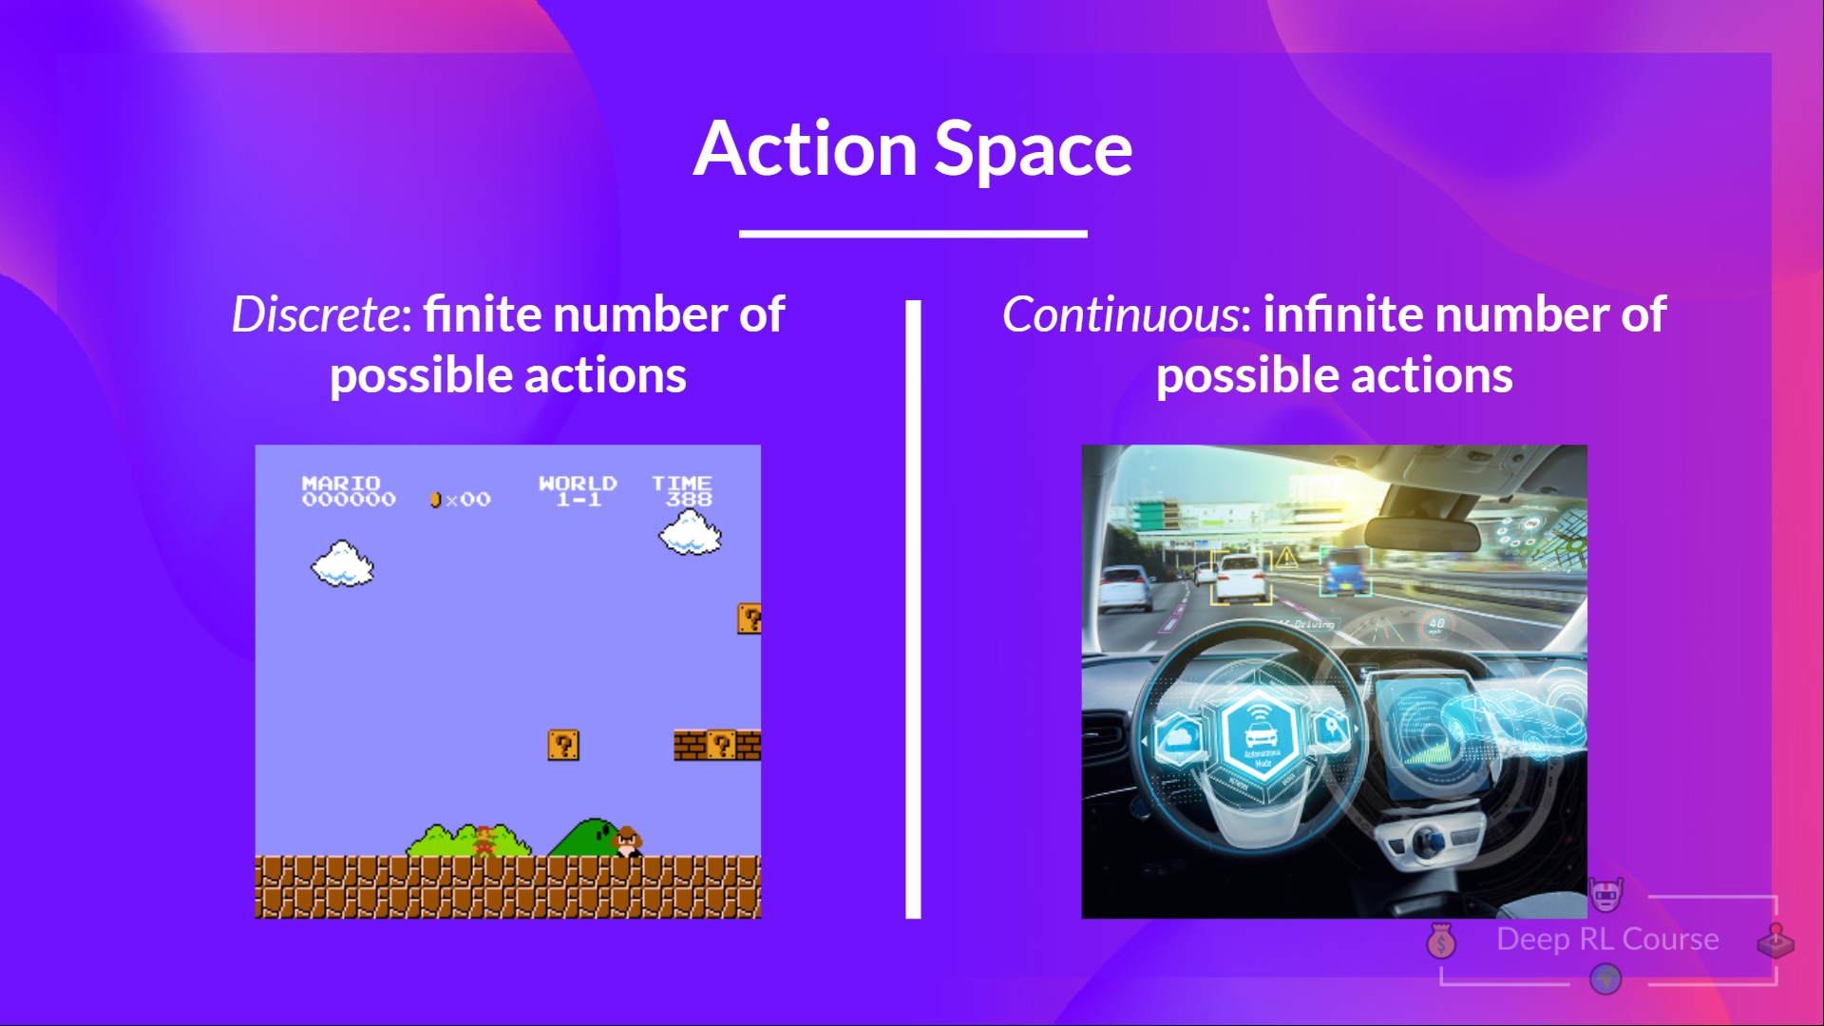
Reinforcement Learning: Introduction

Slide 7
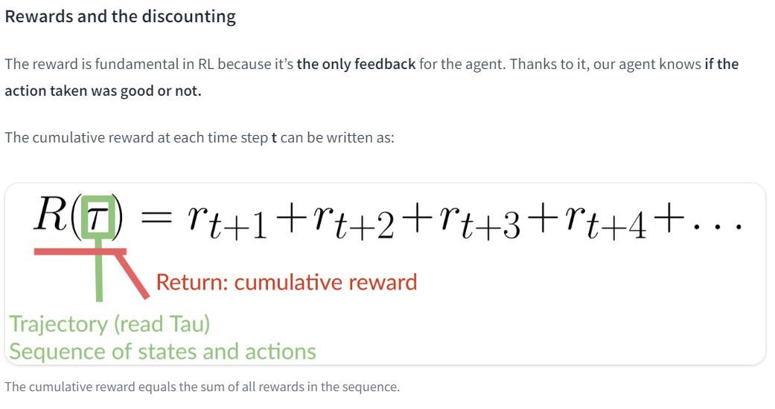
Reinforcement Learning: Introduction

Slide 8
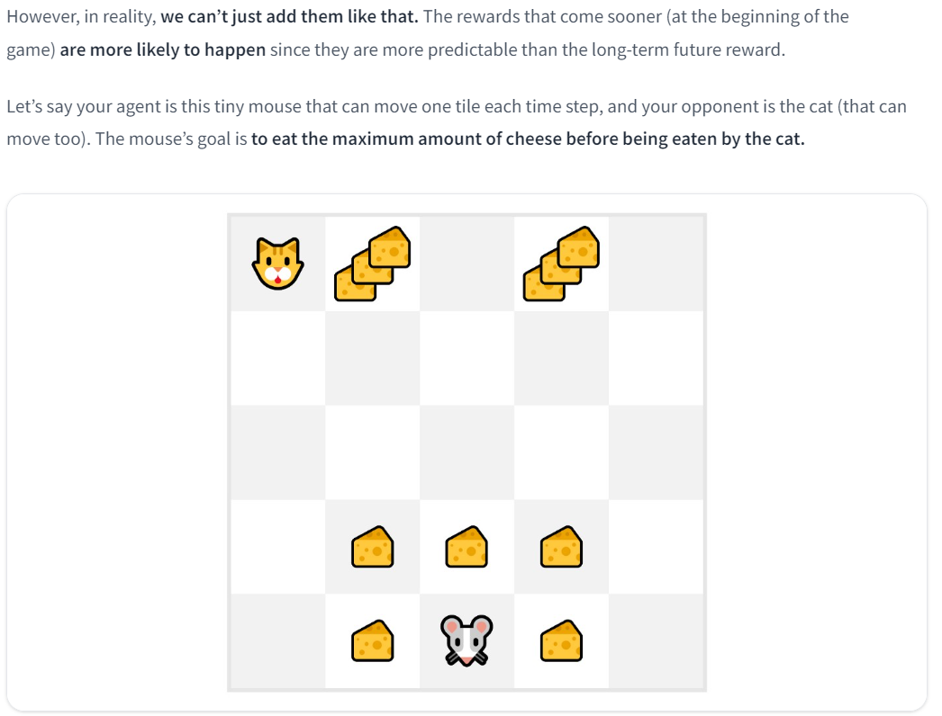
Reinforcement Learning: Introduction

Slide 9
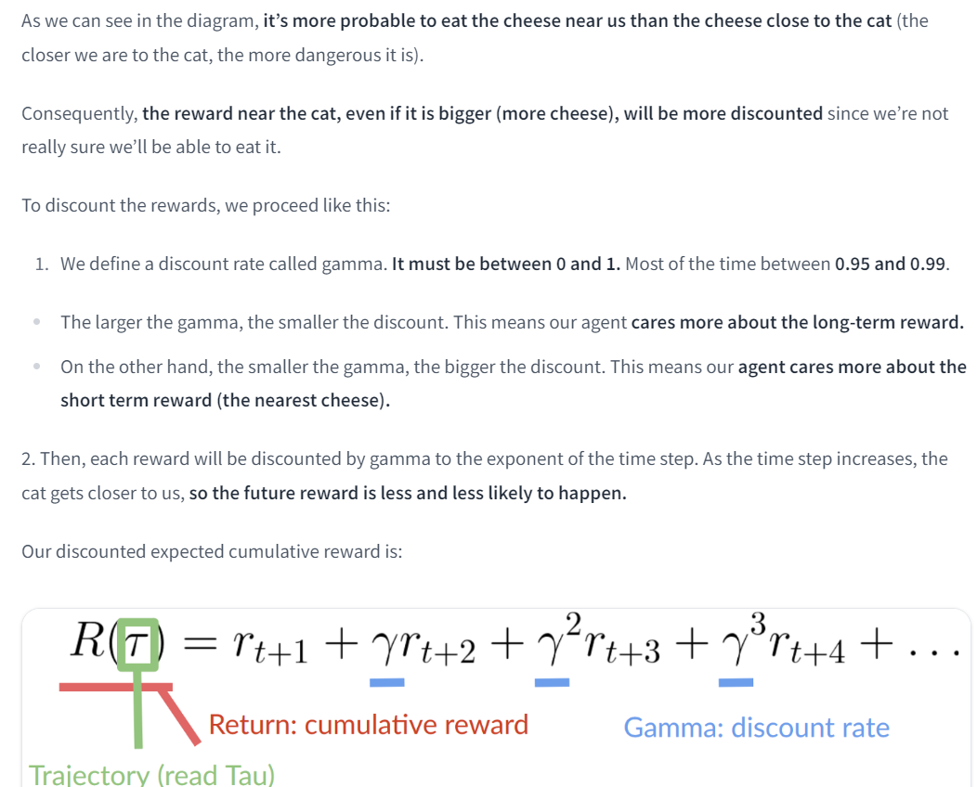
Reinforcement Learning: Introduction

Slide 10
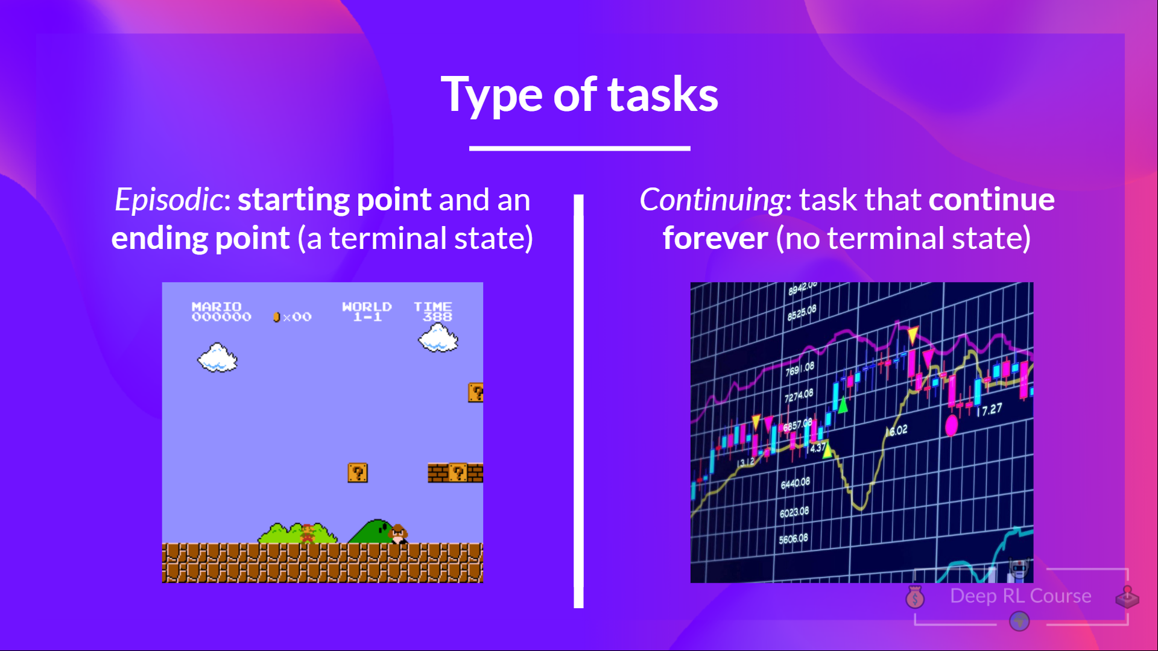
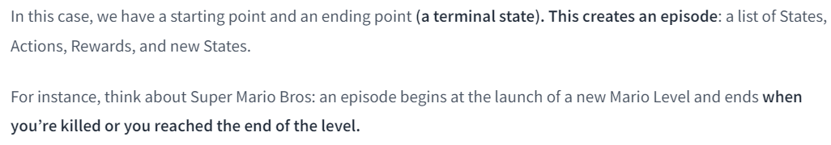
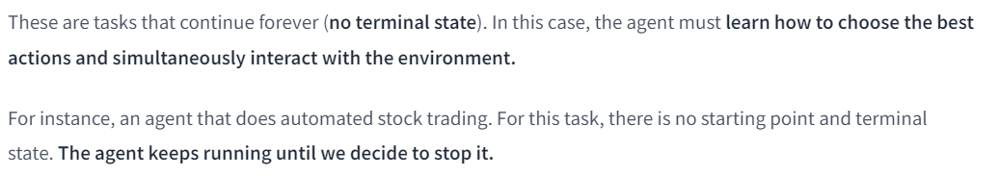
Reinforcement Learning: Introduction

Slide 11
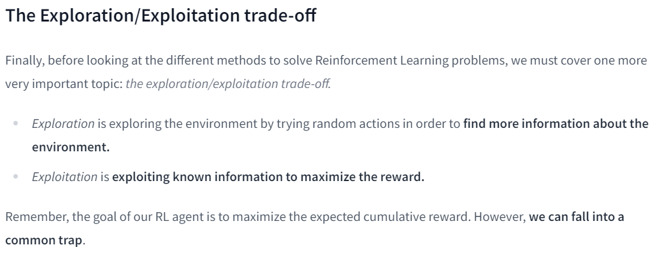
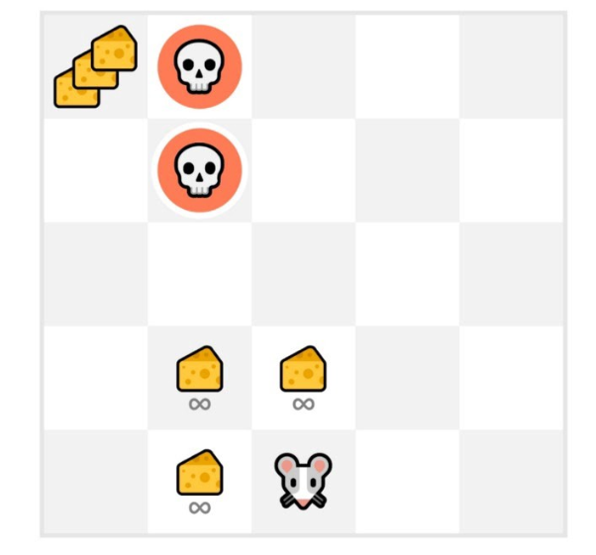
Reinforcement Learning: Introduction

Slide 12
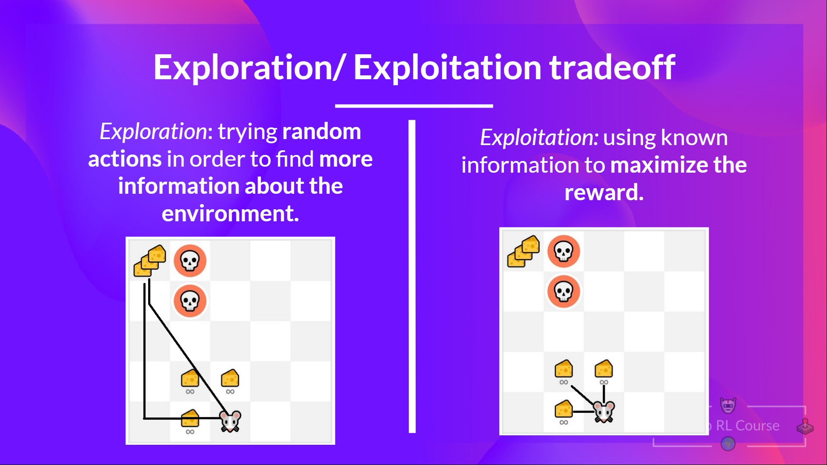
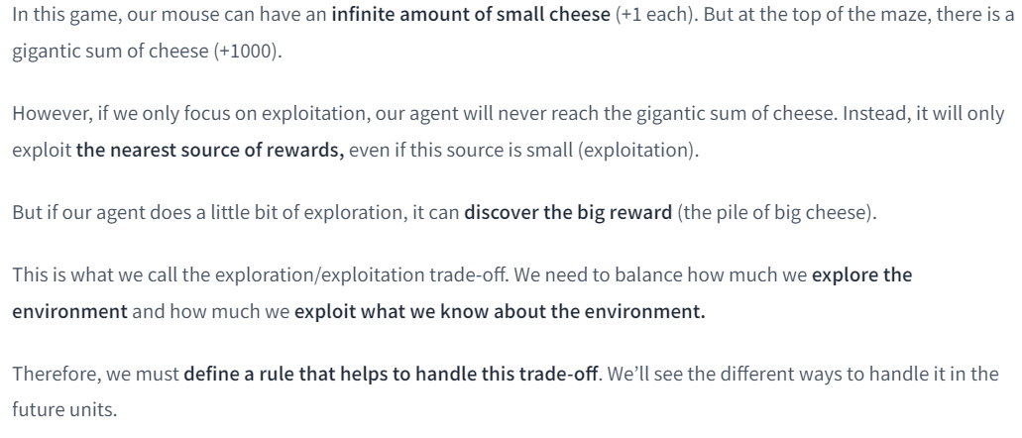
Reinforcement Learning: Introduction

Slide 13
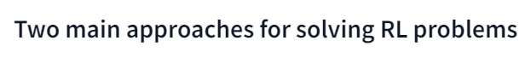
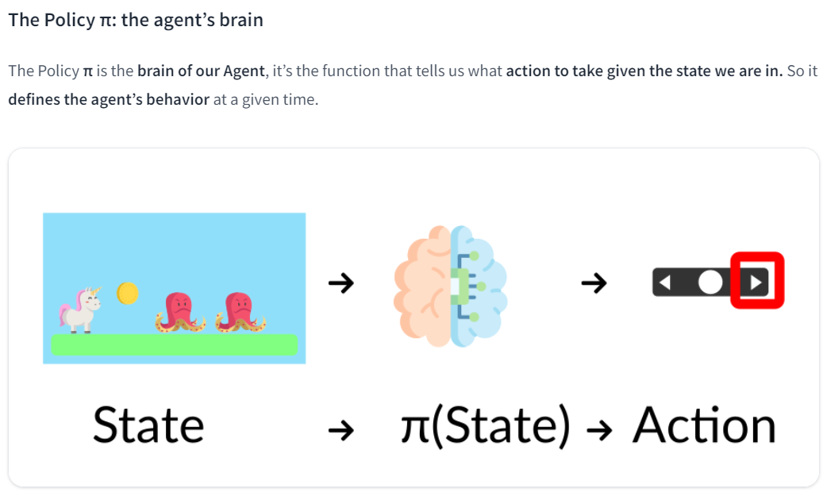
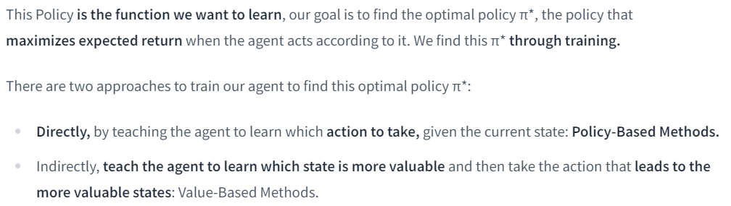
Reinforcement Learning: Introduction

Slide 14
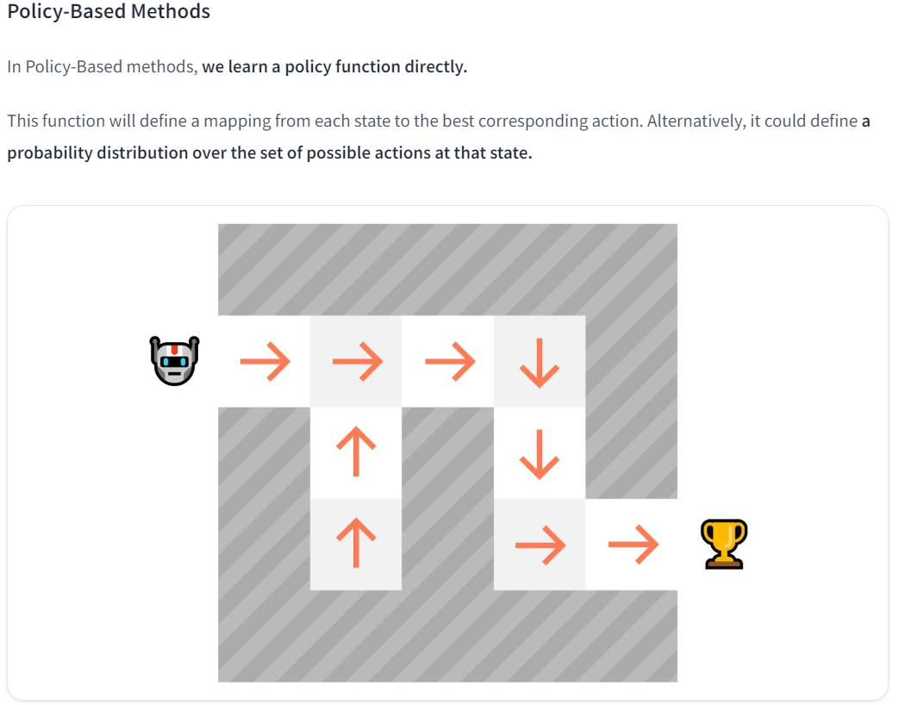
Reinforcement Learning: Introduction

Slide 15
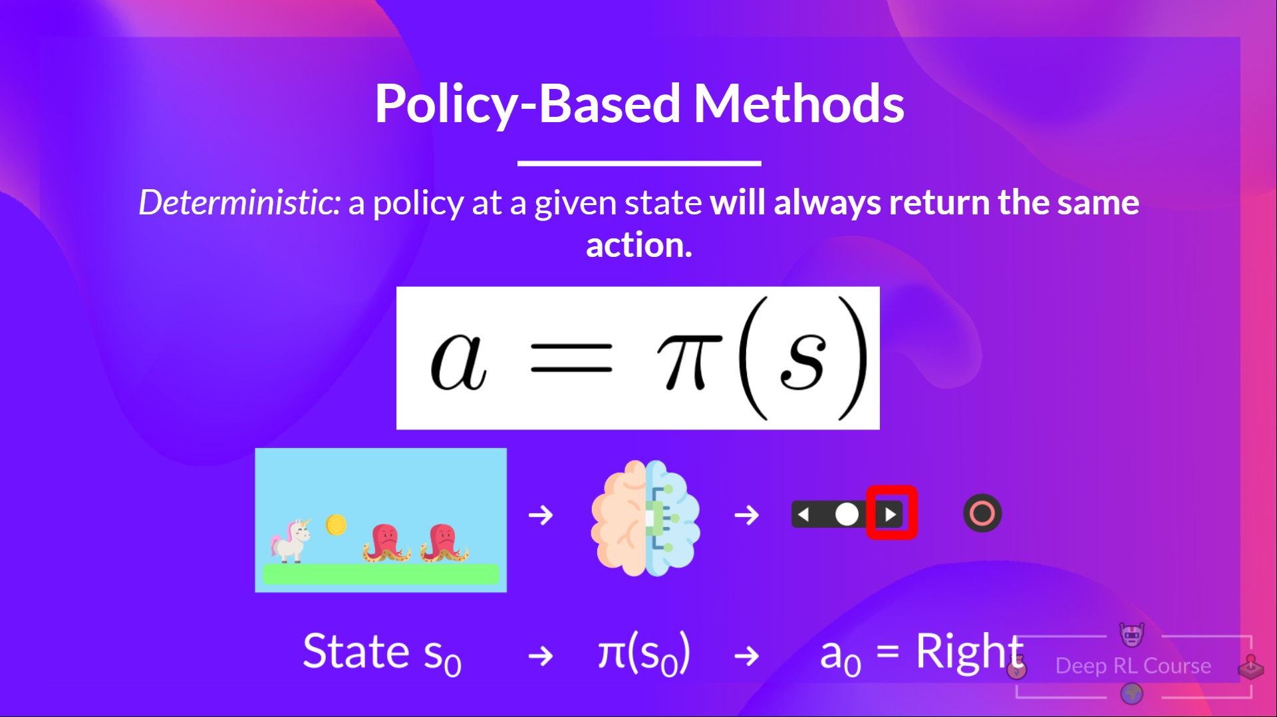
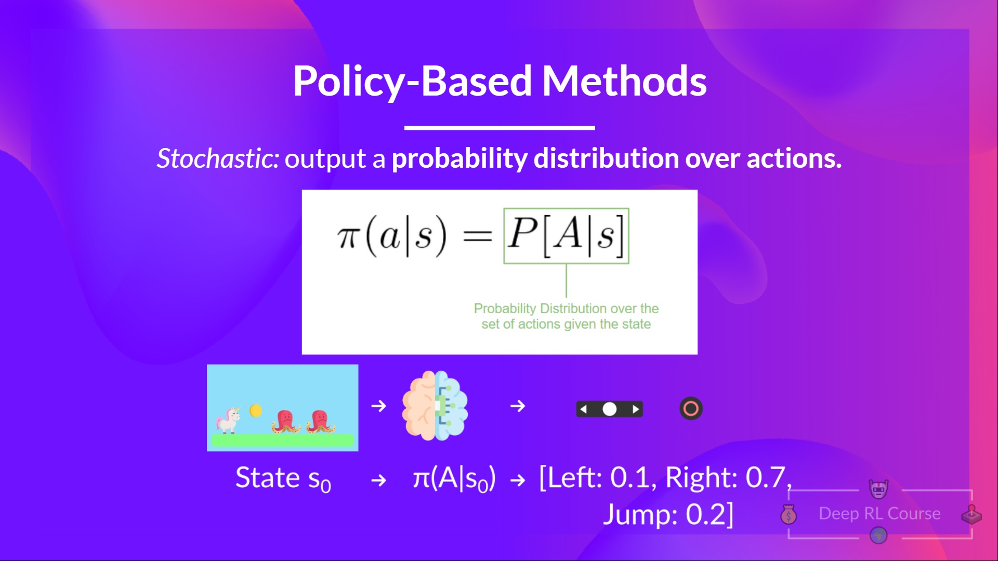
Reinforcement Learning: Introduction

Slide 16
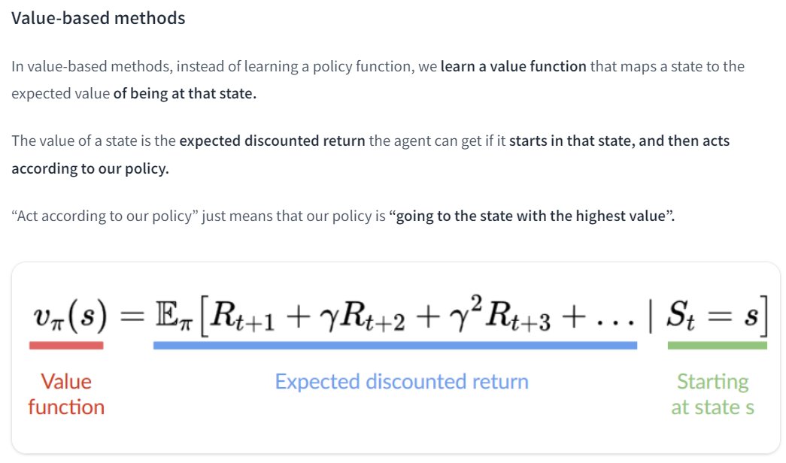
Reinforcement Learning: Introduction

Slide 17
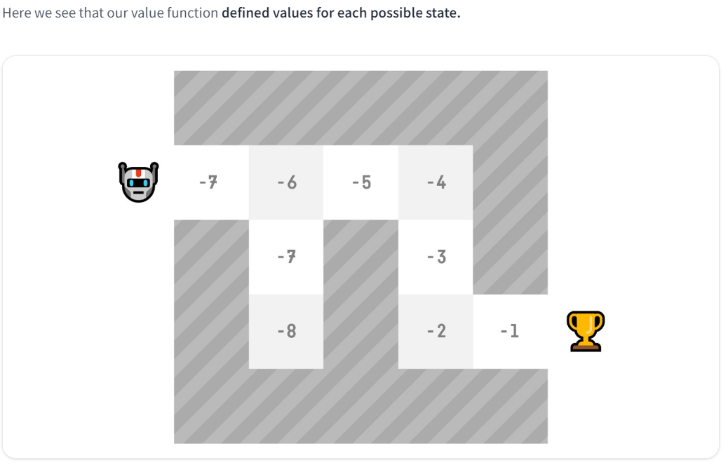
Reinforcement Learning: Introduction

Slide 18
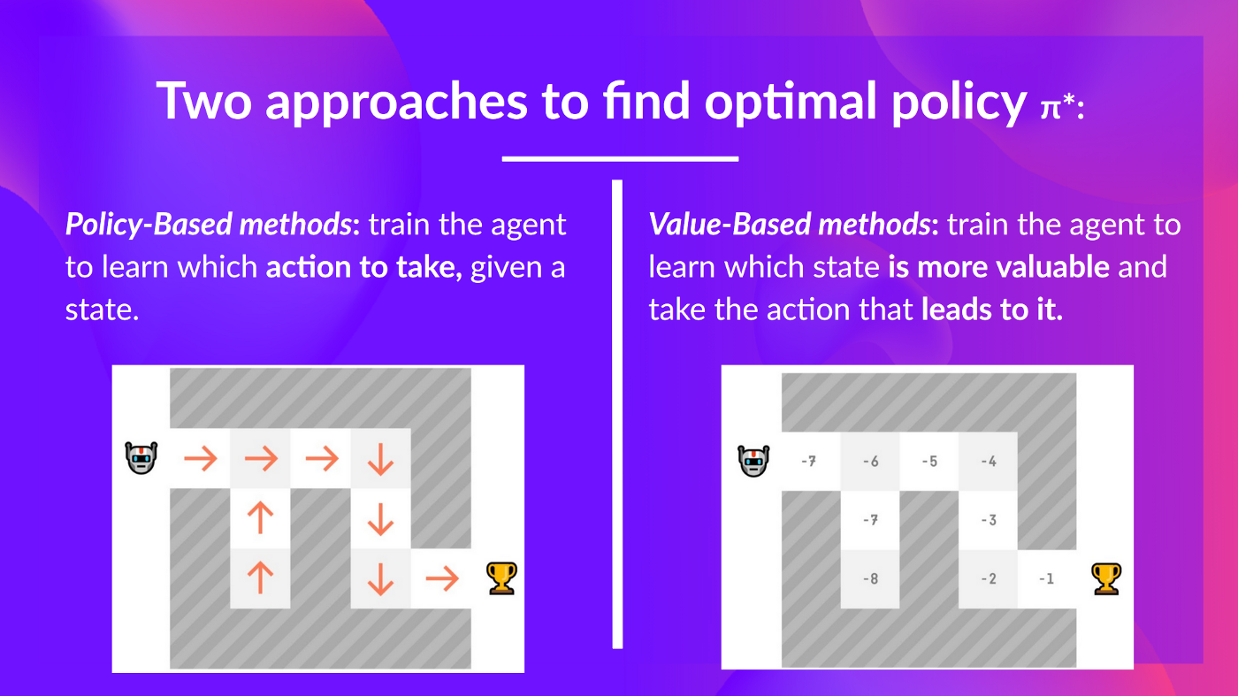
Reinforcement Learning: Recap

Slide 19
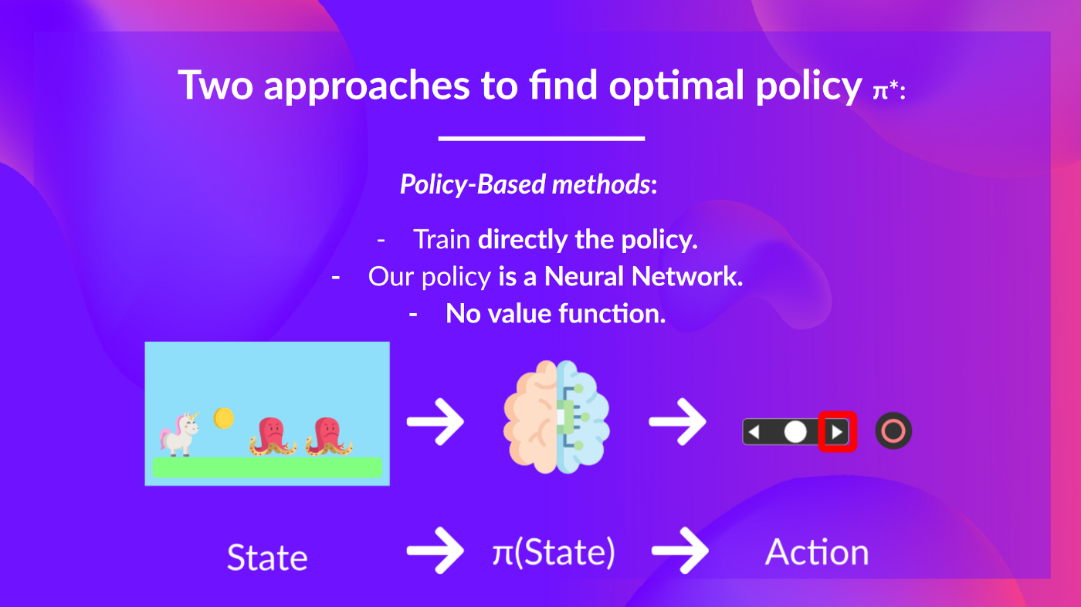
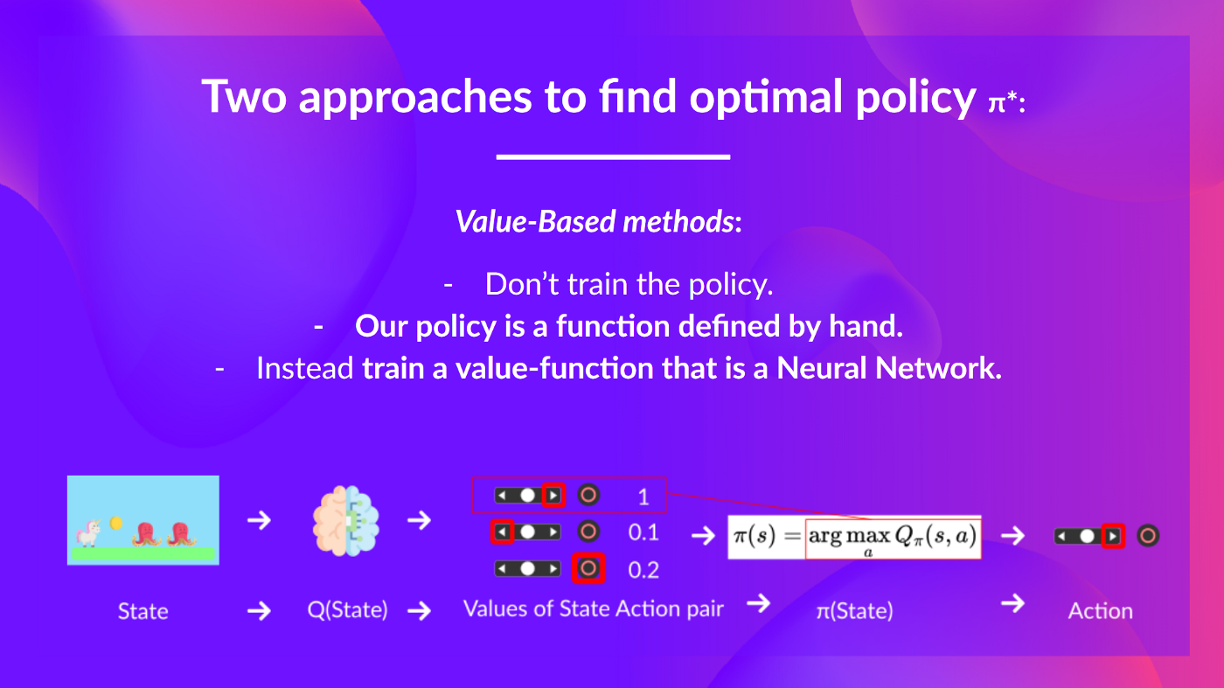
Reinforcement Learning: Recap

Slide 20
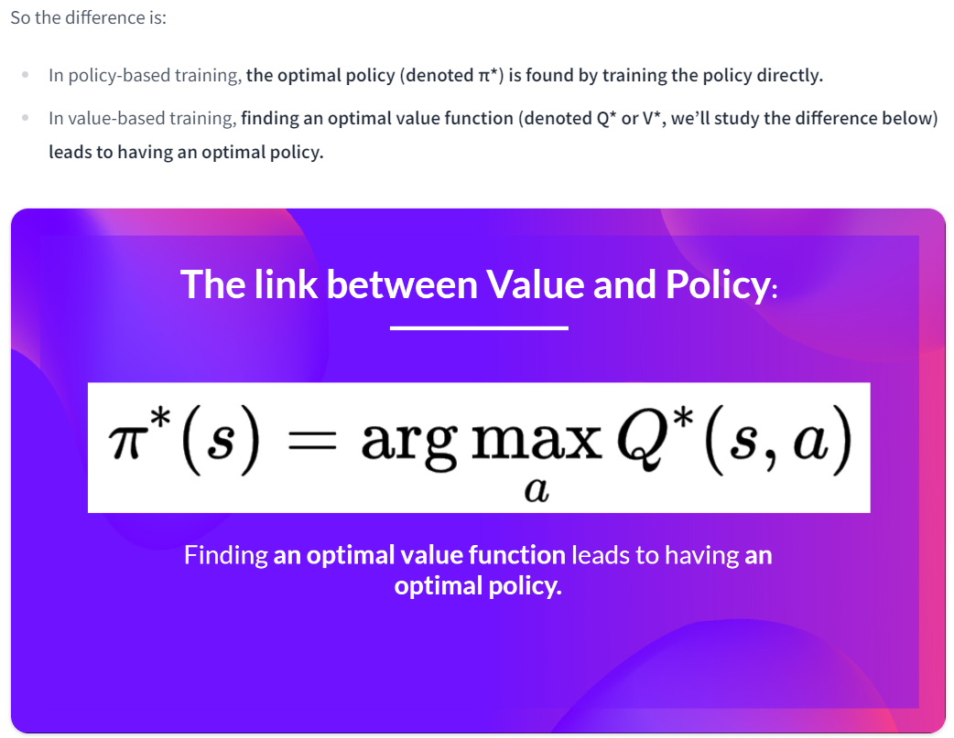
Reinforcement Learning: Recap

Slide 21
Literature and other Sources
Deep Reinforcement Learning
Reinforcement Learning: An Introduction, Richard Sutton and Andrew G. Barto Chapter 1, 2 and 3
Foundations of Deep RL Series, L1 MDPs, Exact Solution Methods, Max-ent RL by Pieter Abbeel
Spinning Up RL by OpenAI Part 1: Key concepts of RL
Gym
Getting Started With OpenAI Gym: The Basic Building Blocks
Make your own Gym custom environment

Slide 22
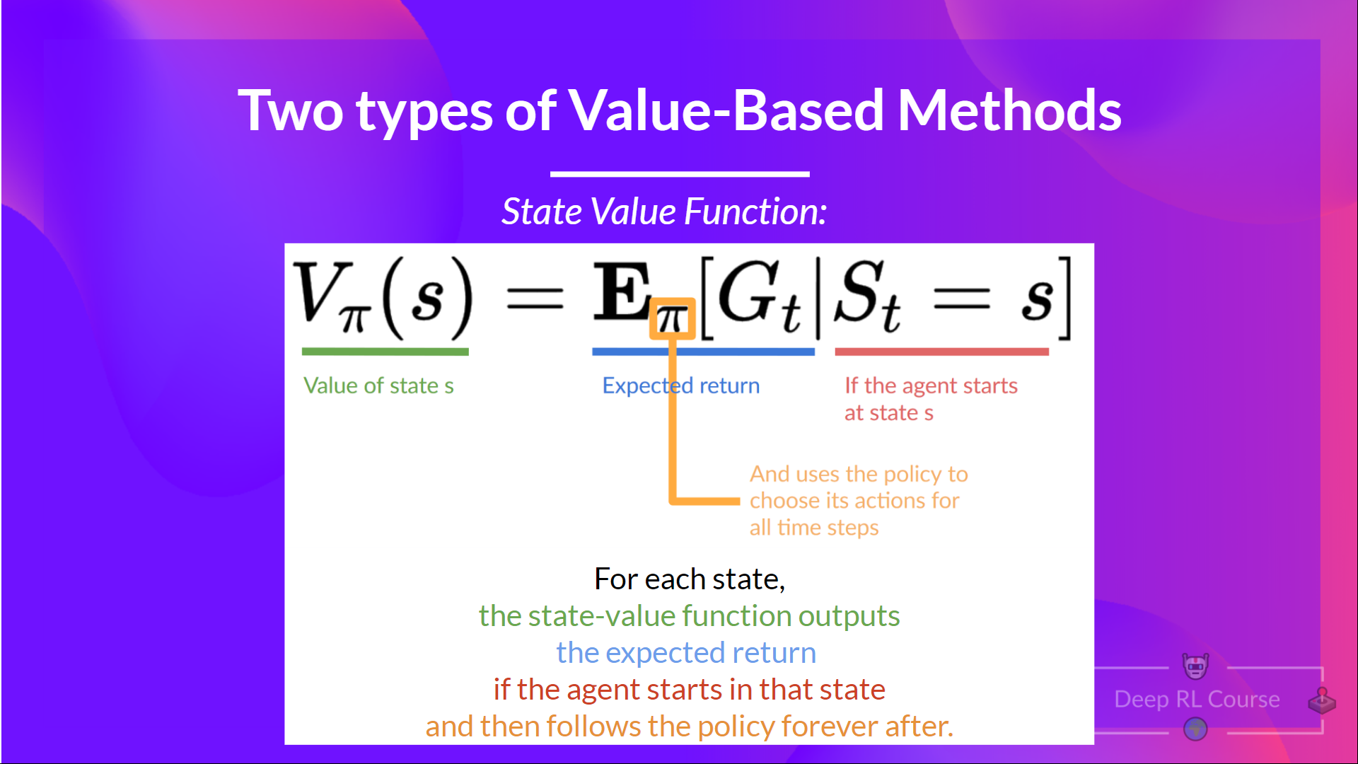
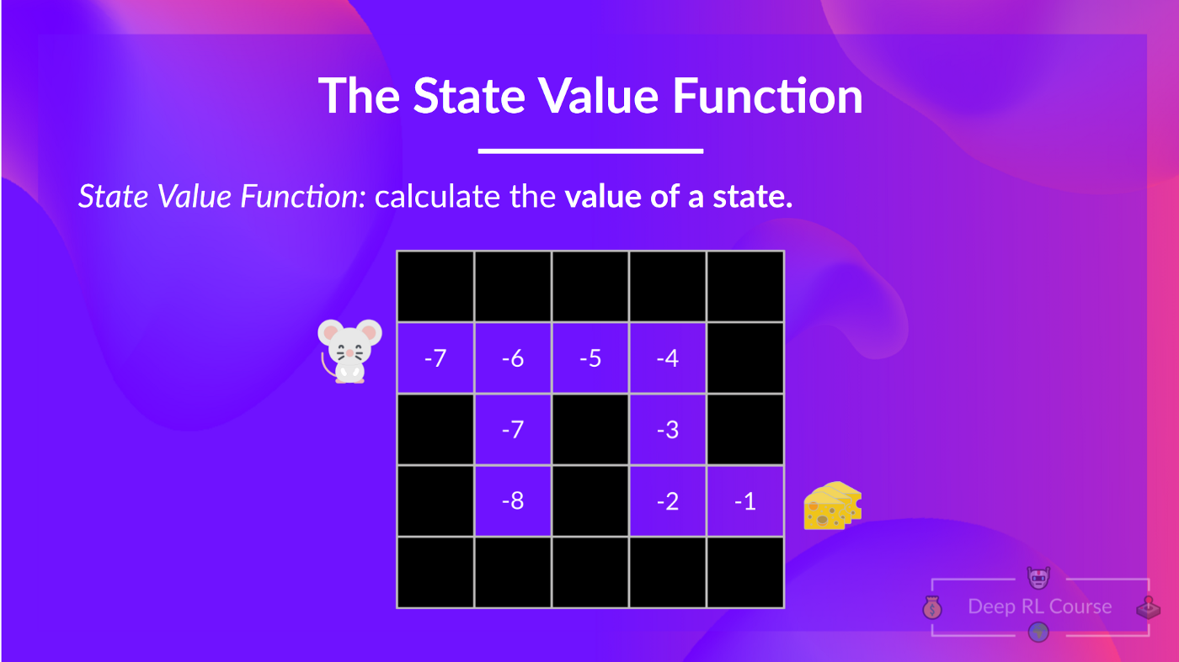
Reinforcement Learning: Q-Learning

Slide 23
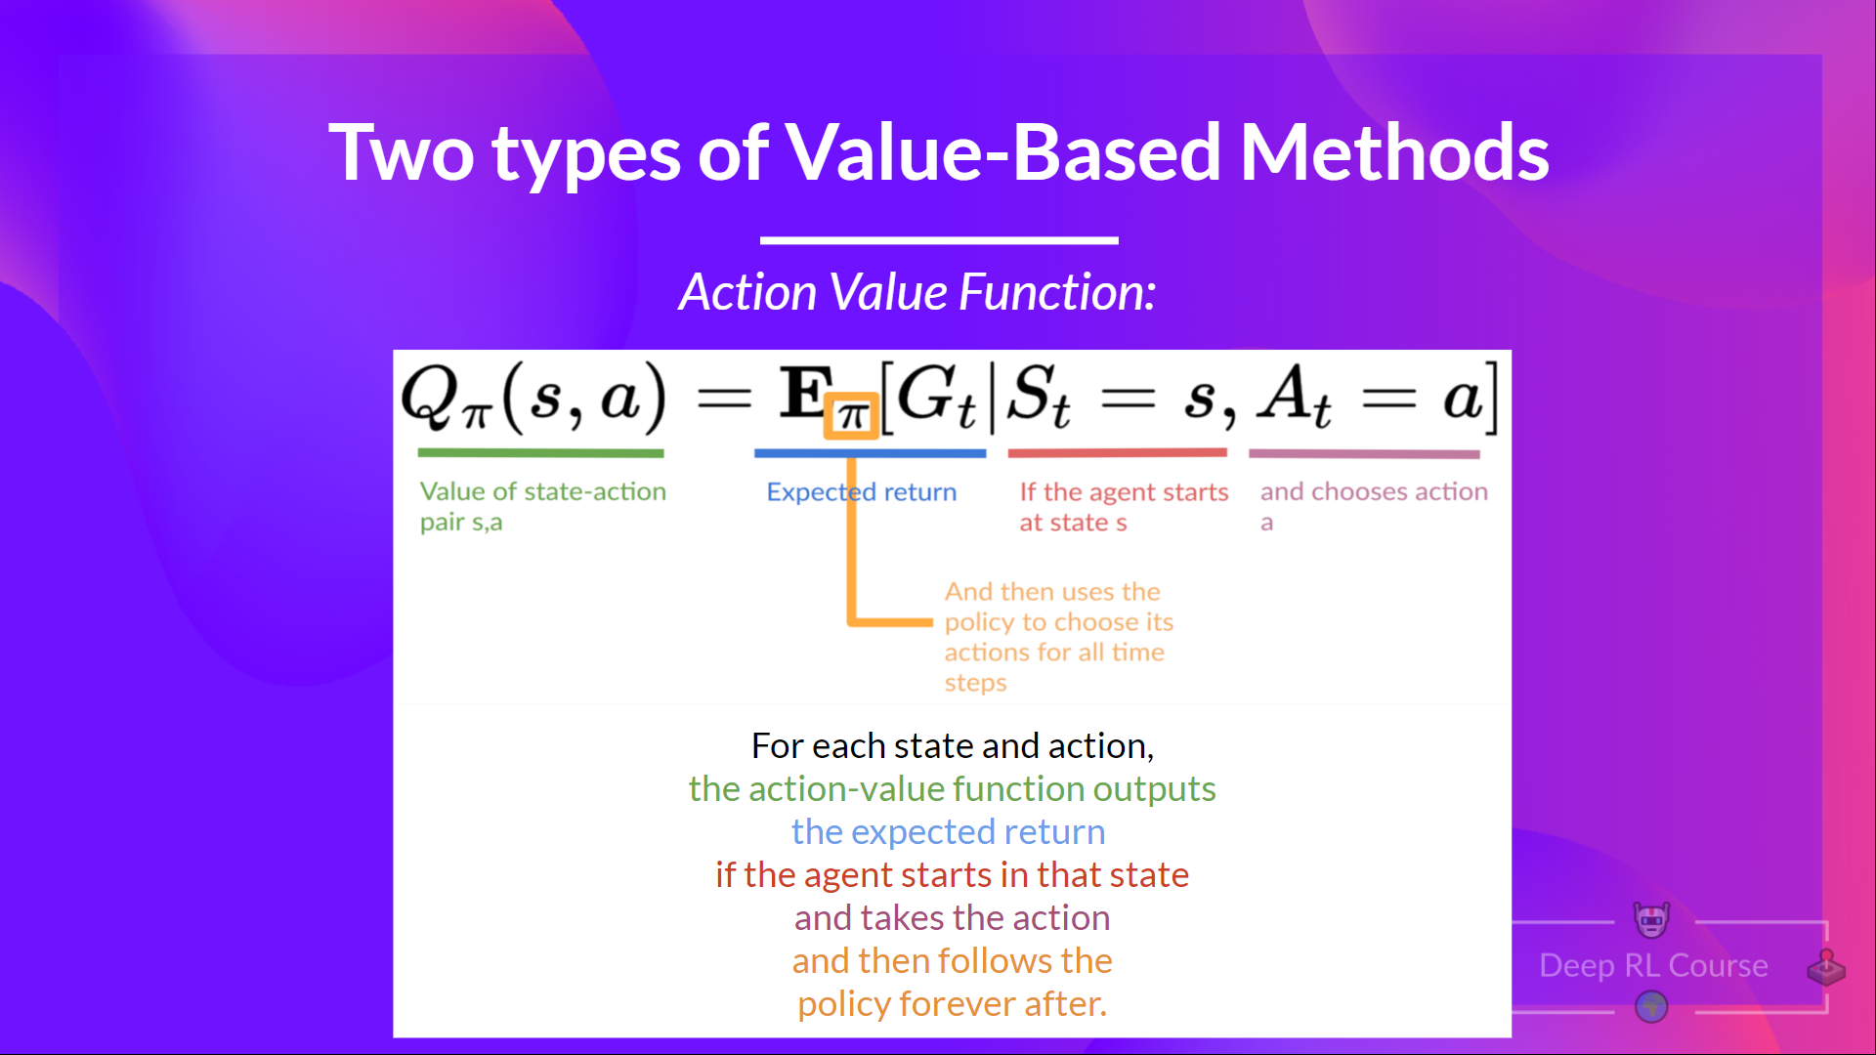
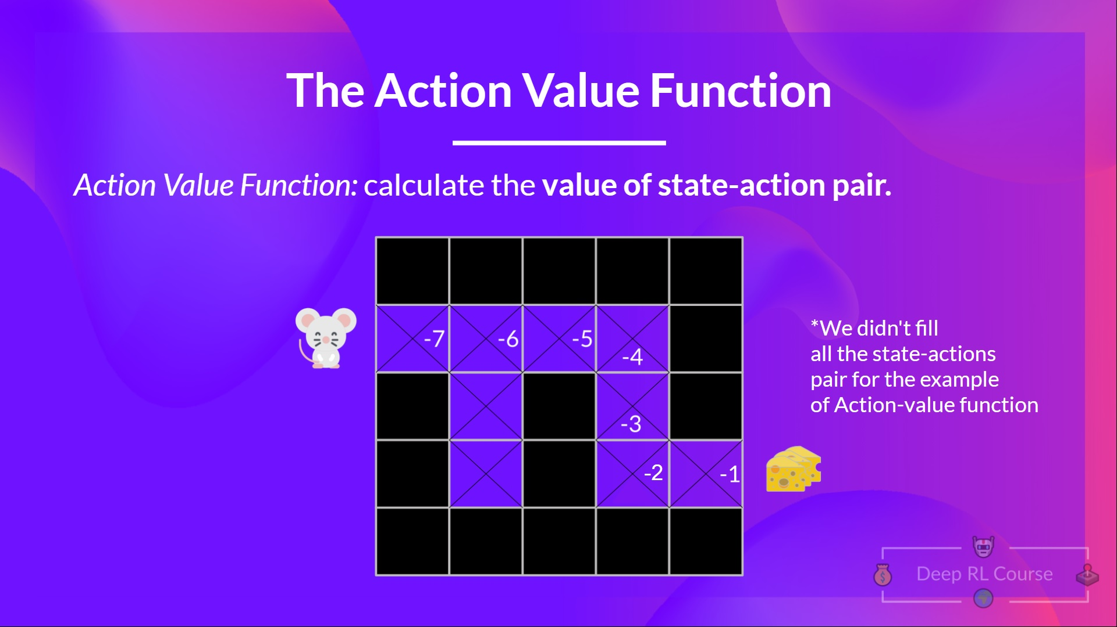
Reinforcement Learning: Q-Learning

Slide 24
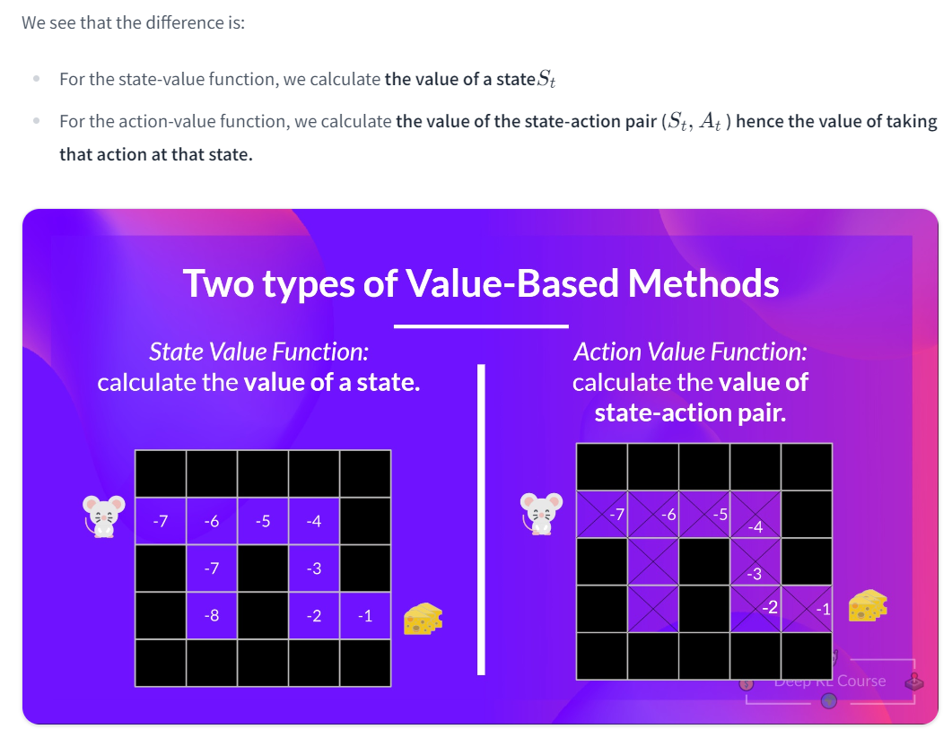
Reinforcement Learning: Q-Learning

Slide 25
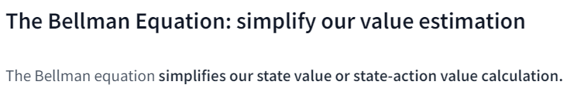
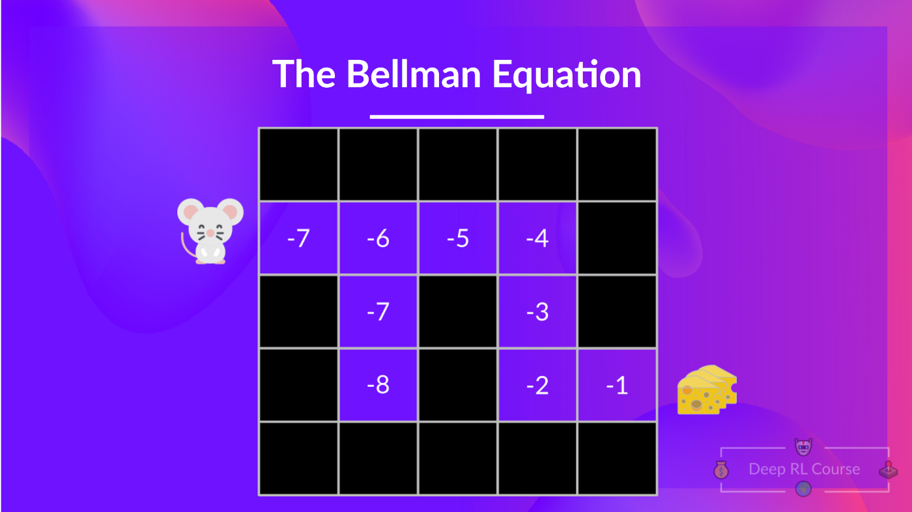
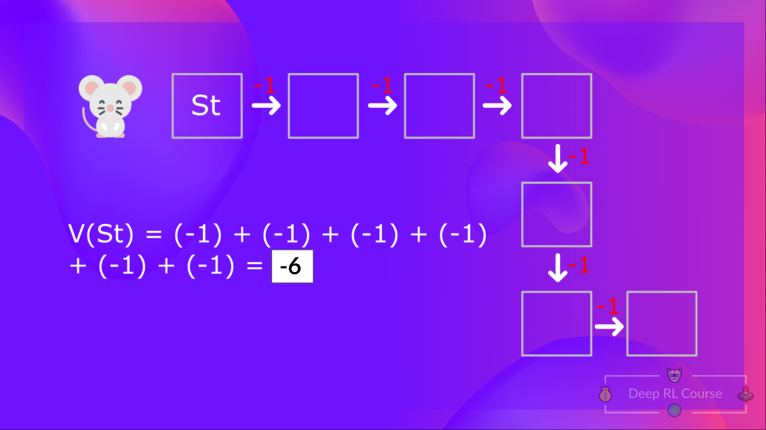
Reinforcement Learning: Q-Learning

Slide 26
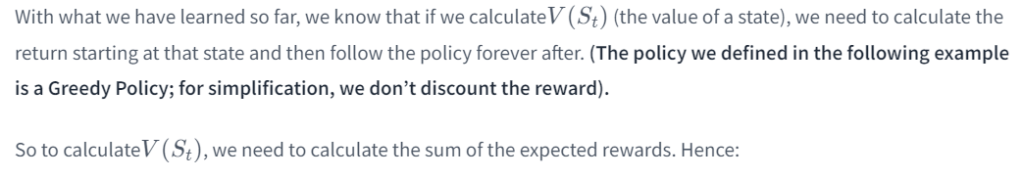
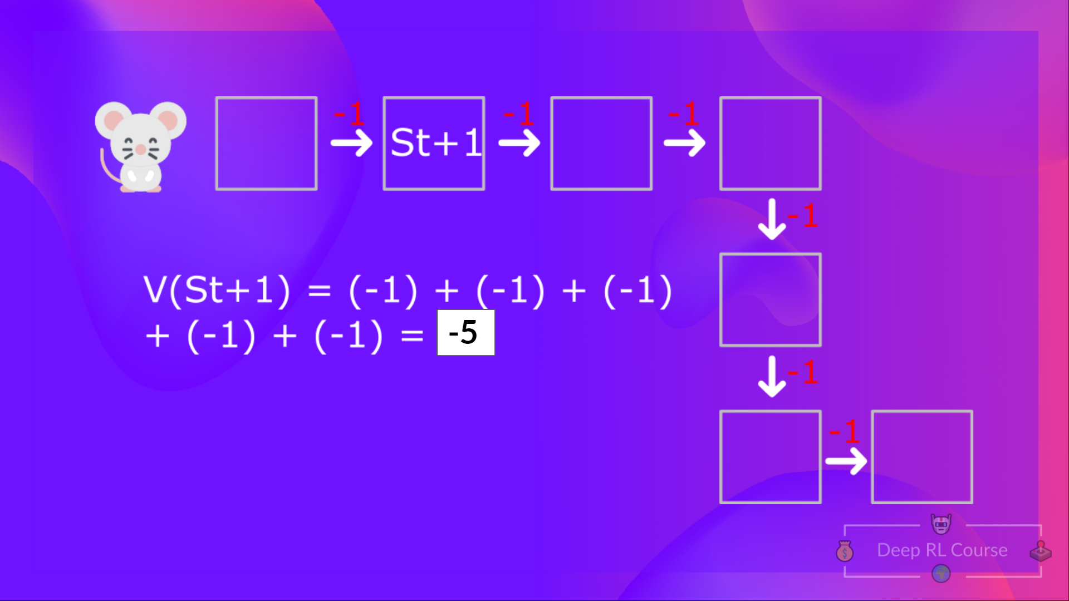
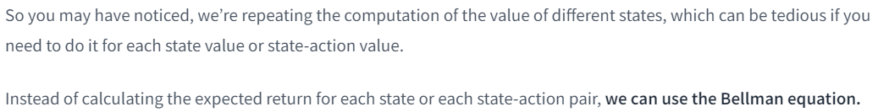
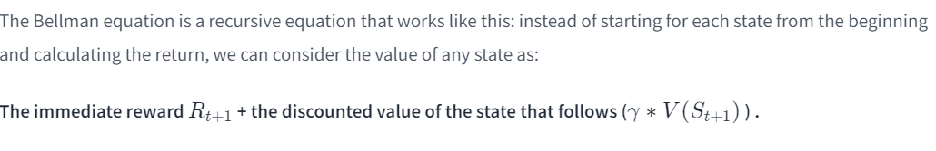
Reinforcement Learning: Q-Learning

Slide 27
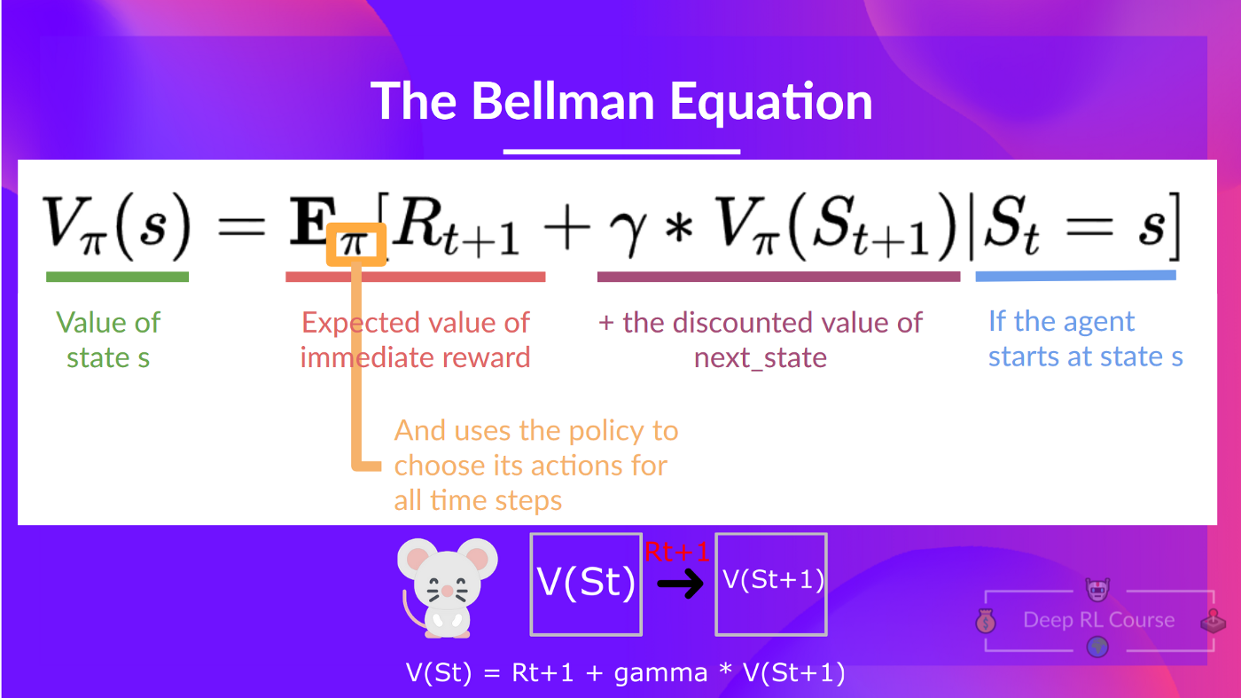
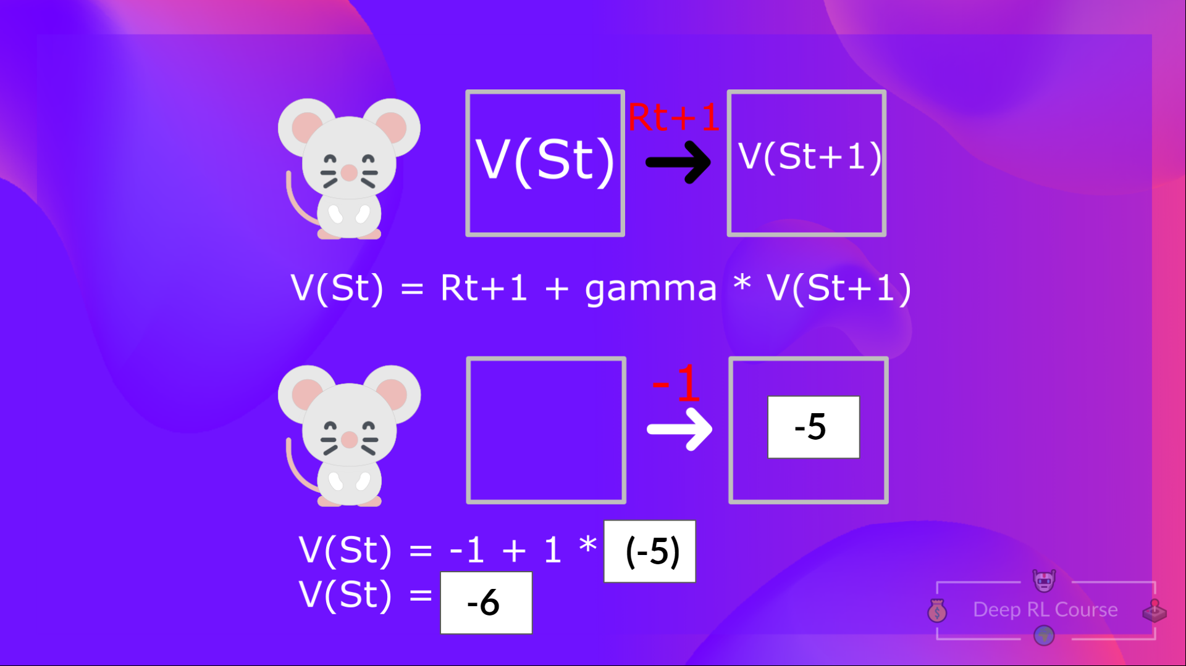
Reinforcement Learning: Q-Learning

Slide 28
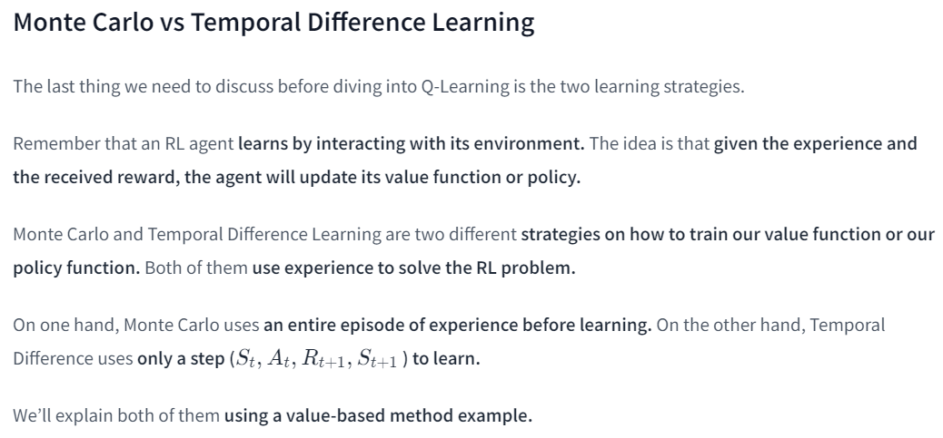
Reinforcement Learning: Q-Learning

Slide 29
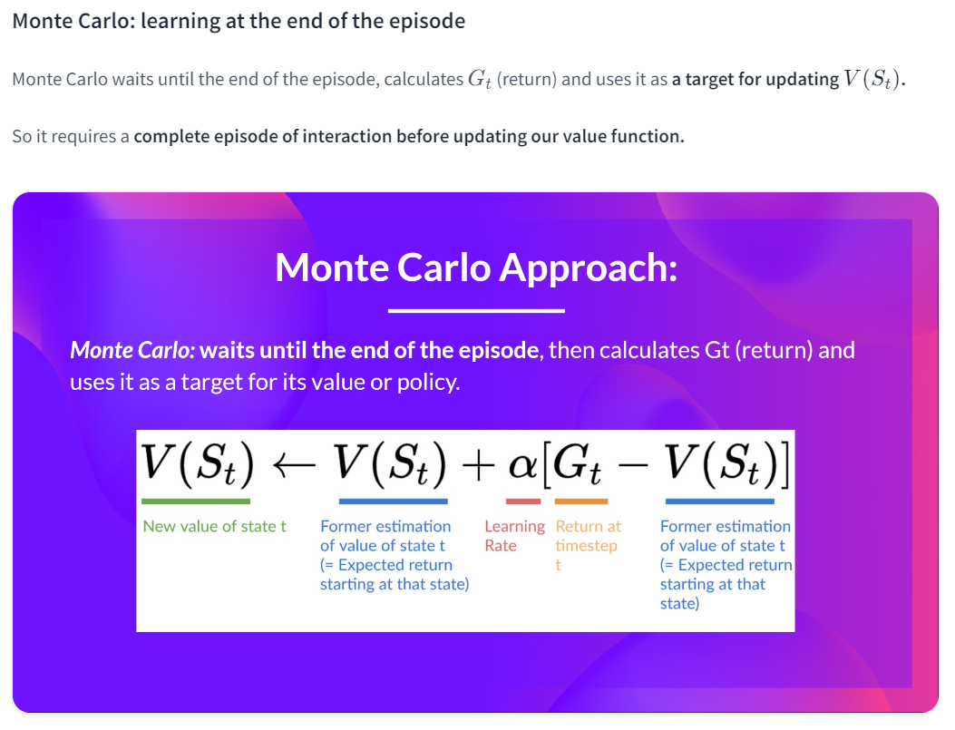
Reinforcement Learning: Q-Learning

Slide 30
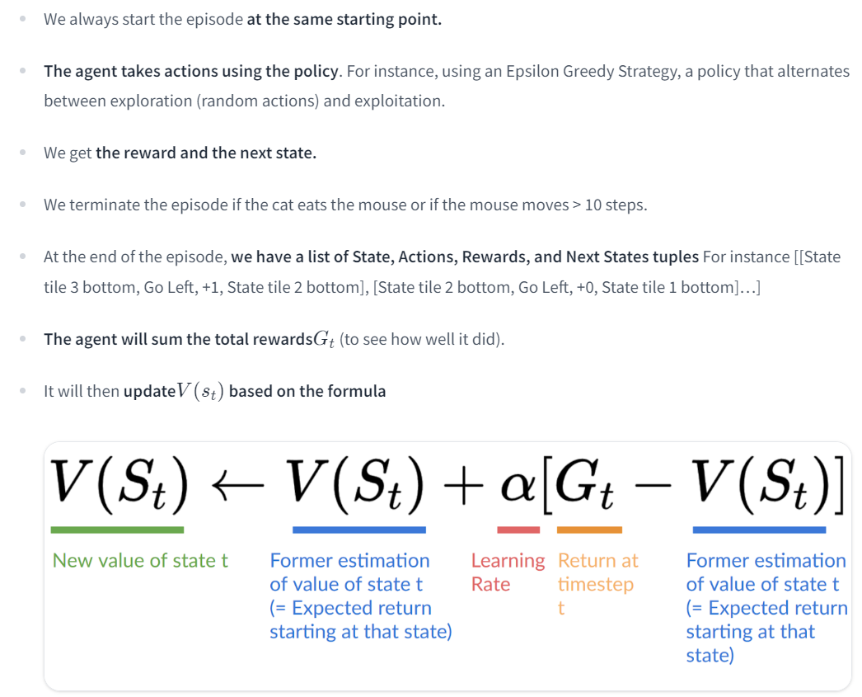
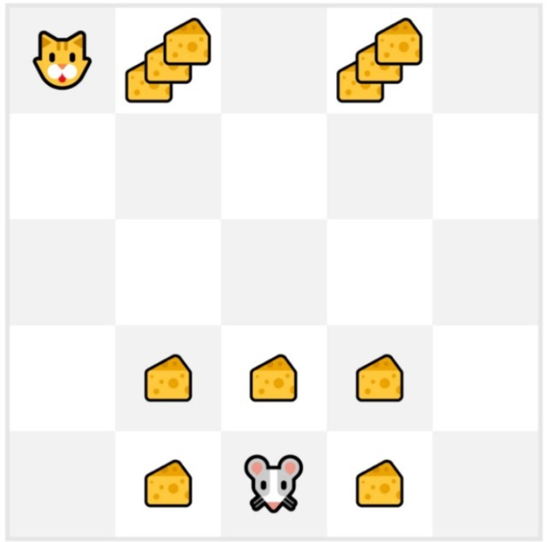
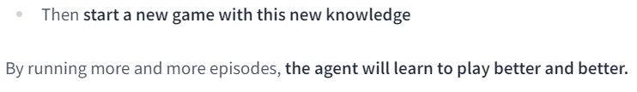
Reinforcement Learning: Q-Learning

Slide 31
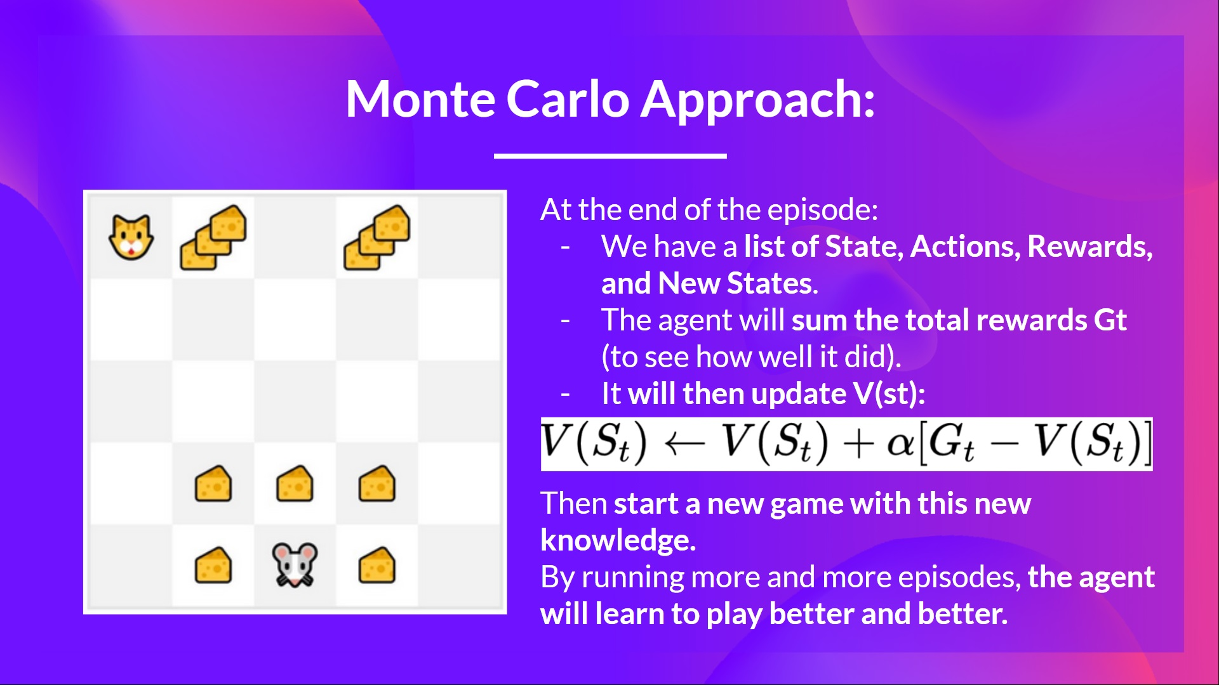
Reinforcement Learning: Q-Learning

Slide 32
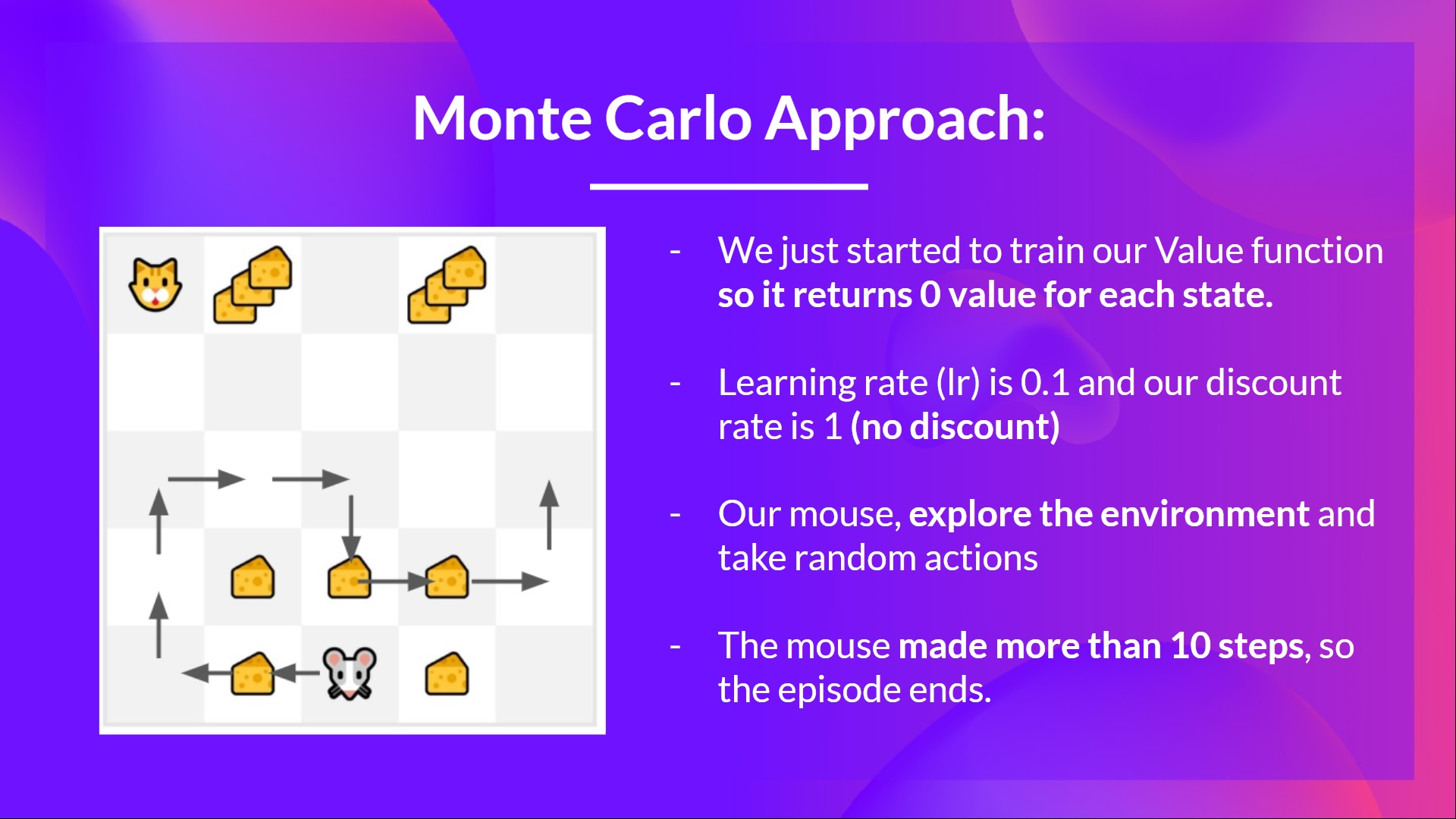
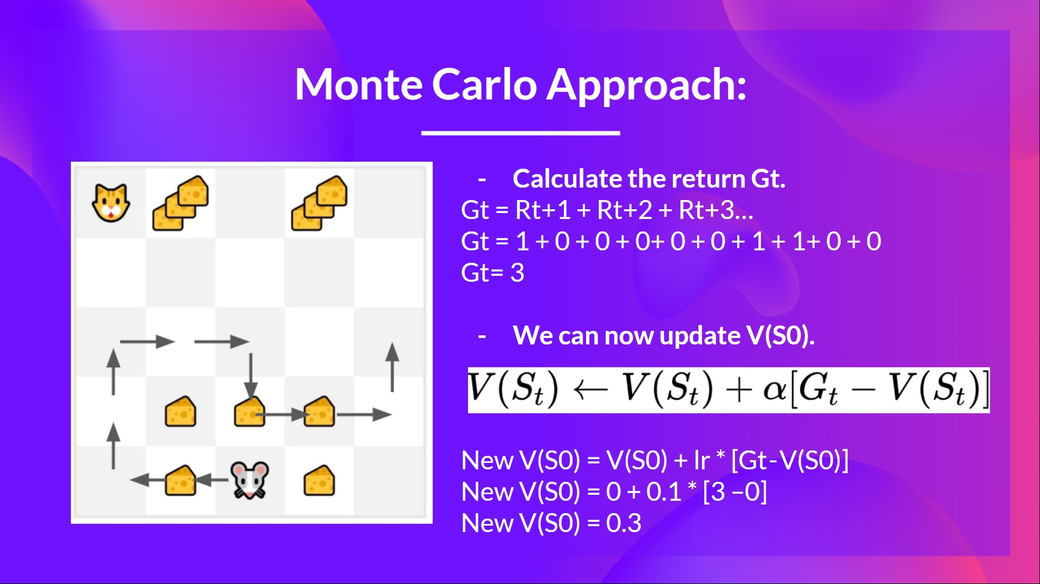
Reinforcement Learning: Q-Learning

Slide 33

Reinforcement Learning: Q-Learning

Slide 34


Reinforcement Learning: Q-Learning

Slide 35



Reinforcement Learning: Q-Learning

Slide 36

Reinforcement Learning: Q-Learning

Slide 37

Reinforcement Learning: Q-Learning

Slide 38


Reinforcement Learning: Q-Learning

Slide 39


Reinforcement Learning: Q-Learning

Slide 40

Reinforcement Learning: Q-Learning

Slide 41

Reinforcement Learning: Q-Learning

Slide 42

Reinforcement Learning: Q-Learning

Slide 43

Reinforcement Learning: Q-Learning

Slide 44

Reinforcement Learning: Q-Learning

Slide 45


Reinforcement Learning: Q-Learning

Slide 46

Reinforcement Learning: Q-Learning

Slide 47

Reinforcement Learning: Q-Learning

Slide 48


Reinforcement Learning: Q-Learning

Slide 49

Reinforcement Learning: Q-Learning

Slide 50




Reinforcement Learning: Q-Learning
Time step 1

Slide 51



Reinforcement Learning: Q-Learning
Time step 1 (continued)

Slide 52



Reinforcement Learning: Q-Learning
Time step 2
NEW EPISODE STARTS

Slide 53
Literature and other sources
Monte Carlo and TD Learning
Why do temporal difference (TD) methods have lower variance than Monte Carlo methods?
When are Monte Carlo methods preferred over temporal difference ones?
Q-Learning
Reinforcement Learning: An Introduction, Richard Sutton and Andrew G. Barto Chapter 5, 6 and 7
Foundations of Deep RL Series, L2 Deep Q-Learning by Pieter Abbeel

Slide 54


From Q-Learning to Deep Q-Learning

Slide 55

From Q-Learning to Deep Q-Learning

Slide 56


The Deep Q-Network (DQN)

Slide 57



The Deep Q-Network (DQN)

Slide 58


The Deep Q-Network (DQN)

Slide 59


The Deep Q-Learning Algorithm

Slide 60

The Deep Q-Learning Algorithm

Slide 61


The Deep Q-Learning Algorithm

Slide 62


The Deep Q-Learning Algorithm

Slide 63




The Deep Q-Learning Algorithm

Slide 64


The Deep Q-Learning Algorithm

Slide 65


The Deep Q-Learning Algorithm
by Hado van Hasselt

Slide 66
Literature and other Sources
These are optional readings if you want to go deeper.
Foundations of Deep RL Series, L2 Deep Q-Learning by Pieter Abbeel
Playing Atari with Deep Reinforcement Learning
Double Deep Q-Learning
Prioritized Experience Replay
Dueling Deep Q-Learning

Slide 67

Ideas for projects and other Examples
https://neptune.ai/blog/best-reinforcement-learning-tutorials-examples-projects-and-courses

